Slide 1
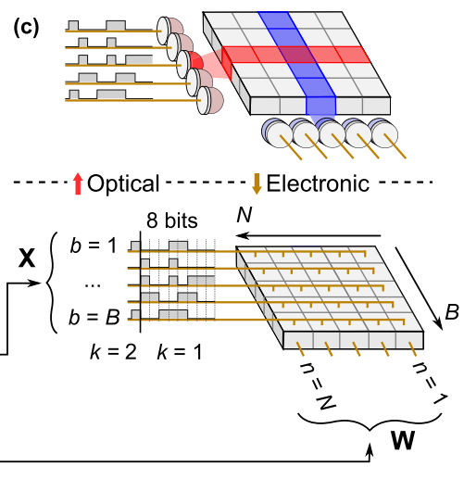
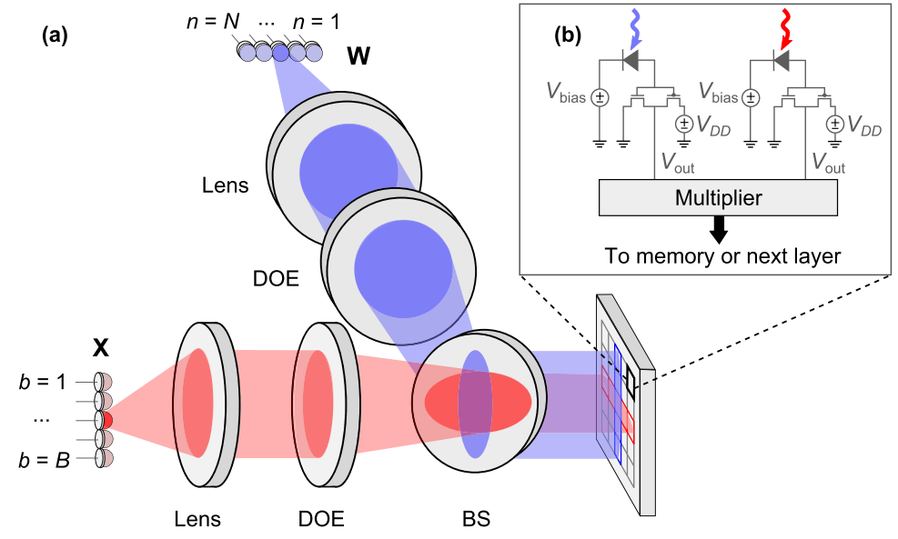
Notes: Freely scalable and reconfigurable optical hardware for deep learning ^{[1,2]}
I. Applications
II. Challenges
1. DNN is prominent and revolutionary, but become more complex. 2. Neural network (NN) scalability is limited by the costs of communication, thermal management, power delivery and clocking of electronic processors. 3. Modern inference accelerators spend the majority of energy (> 90%) on memory access, data movement, and computation in fully-connected and convolutional layers.
Though optical systems have been proposed to perform linear algebra and data transmission, analog weighting of optical inputs have system errors that can decrease the accuracy of large DNN models processed. In addition, prior works in digital optical interconnects have focused on integrated point-to-point connections, free-space point-to-point, transmission, and small-scale free-space multicast, which are difficult to scale since they incur significant overhead in number of components and introduce compounded component losses.
III. Methods
IV. Conclusions
1. With minimal impact on accuracy, the DONN yields an energy advantage over all-electronic accelerators when the spacing of computational units is on the order of > 10 µ m.
2. Lower energy consumption and improve efficiency. The energy for DONN to transmit two 8-bit values remains constant at ∼ 3 fJ/MAC, whereas inter-chiplet electrical interconnect costs ∼ 1000 fJ/MAC, and inter-chip systems cost ∼ 30, 000 fJ/MAC. The efficient optical data distribution provided by the DONN architecture will become critical for continued growth of DNN performance through increased model sizes and greater connectivity.
3. Independent of data transmission length. Newer neural network models (e.g., GNN) require irregular connectivity, and are restricted in size due to insufficient compute power. These systems have arbitrary connections with potentially long wire lengths between MAC units, representing different edges in the graph. The DONN can implement these links without incurring additional costs in energy.
4. Beyond neural networks, DONN-style architecture can accelerate any computation with matrix multiplication, such as optimization, Ising machines and statistical analysis.
光连接
Source: Figure 2(c) and 3 [1]
电连接
Digital optical neural network (DONN):
1. Entirely digital system, comparing to [3]
2. As above, passively transmit and copy data for matrix-matrix (X-W) multiplication. Fan-out, data is read once from main memory (DRAM) and used multiple times. This diffractive optical element (DOE), beamsplitter (BS).
2. Incoherent optical paths for data transmission replace electrical on-chip interconnects, and can thus preserve accuracy.
3. DONN architecture replaces electrical interconnects with optical links to relax the design constraints of reducing inter-multiplier spacing or colocating multipliers with memory.
[1] https://www.nature.com/articles/s41598-021-82543-3
[2] https://github.com/alexsludds/Digital-Optical-Neural-Network-Code
[3] https://journals.aps.org/prx/abstract/10.1103/PhysRevX.9.021032

Slide 2
笔记: 用于深度学习的可自由扩展和可重新配置的光学硬件 ^{[1,2]}
I. 应用
II. 痛点
DNN架构变得功能更强大，但计算更复杂。Neural network (NN) 的扩展受到网内通信成本、热管理、电使用和电时钟的限制。现代NN将大部分能量（> 90%）用于内存访问、数据移动和全连接层和卷积层的计算。
尽管已有光学系统来执行线性代数和数据传输，但光输入的模拟加权存在系统误差，会降低大型 DNN 模型的准确性。此外，数字光互连的先前研究主要集中在集成的点对点连接、自由空间点对点、传输和小规模自由空间多播。这些方法难以真正实现扩展，因为扩展会产生大量组件开销，以及引入混合损失。
III. 方法
IV. 结论
光连接
1. 跟电连相比，DONN 对精度几乎没有影响，
2. 当计算单元的间距大于 10 µm 时，DONN比全电子加速器具有显著能量优势。DONN 传输两个 8 位值的能量（无论片间或芯间）保持在 ~ 3 fJ/MAC (multiply-and-accumulate)，而片间电连为 ~ 1000 fJ/MAC，芯片间电连为 ~ 30, 000 fJ/MAC。由DONN 架构提供的有效光连数据分布将对 DNN 通过增加模型和连接来改进性能至关重要。
3. DONN耗能不受传输距离影响。较新的神经网络模型（例如 GNN）具有不规则的连通性。如果部分长连通电能不足，会导致整体模型大小受到限制 (GNN系统MAC单元之间的导线长度可能很长，其代表图中的不同边)。使用DONN可以实现长链接，而不会产生额外的能源成本。
4. 除了神经网络，DONN的架构可用于任何有矩阵乘法的计算，例如优化、 Ising机和统计分析。
图源: Figure 2(c) and 3 [1]
电连接
数字光神经网络（Digital optical neural network, DONN）：
1.与 [3] 相比，为完全数字系统。
2. 光静态传输和复制数据以进行矩阵-矩阵（X-W，也可为向量-向量）的乘法运算。如上图，从左到右，最左为比较光连和电连的矩阵扇出(fan-out)，中间为光多(2)路接收，最右上角为光检测转化(0,1)。扇出, 这里指数据被从主存(一次)读出(后多次使用)。DOE为衍射光学元件（diffractive optical element），BS为分束器（ beamsplitter ）。
3. 非相干光路取代了电路连接进行数据传输，因此可以保持精度。
[1] https://www.nature.com/articles/s41598-021-82543-3
[2] https://github.com/alexsludds/Digital-Optical-Neural-Network-Code
[3] https://journals.aps.org/prx/abstract/10.1103/PhysRevX.9.021032

